Slide 1
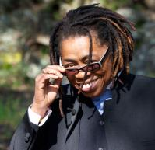
Meet Melanie
WITNESS GUEST ARTIST
2017

Slide 2
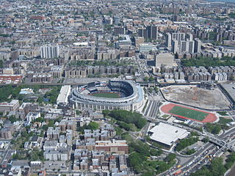
She was born in the Bronx, a borough of New York City, and grew up with music. Her parents were gifted singers who passed down a deep love of music to all of their five children.
Yankee Stadium surrounded by Concourse Village, Bronx, NY

Slide 3
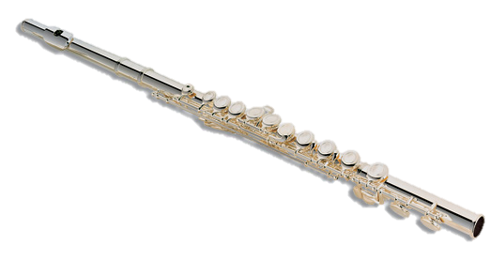
Melanie began piano lesson at age five. In In middle school she played flute and guitar.
Every Christmas for 14 years, she received a new instrument from her parents. She particularly remembers a mandolin, a jaw harp, and a recorder. Some were instruments she’d never seen before. Her job was to figure out how to play them.

Slide 4
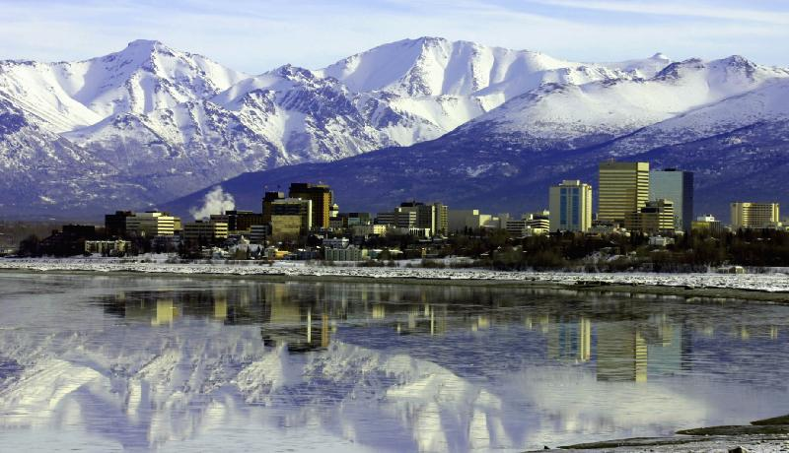
http://nicholecropper.files.wordpress.com/2010/01/1anchorage.jpg
From New York, her family moved to Anchorage, Alaska – near the beautiful, snow covered, mountains.

Slide 5
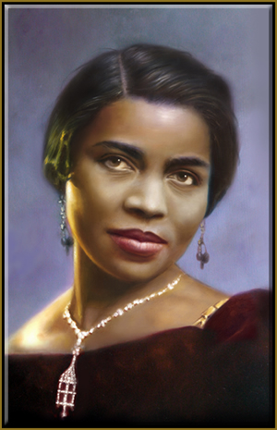
Her parents were fine singers and actors. In Anchorage, they sang in the Opera Chorus during the 1960s.
The chorus sang with guest
artists who came to Anchorage.
One famous artist Melanie
remembers hearing
was Marian Anderson.
Melanie’s mom would often take
her to rehearsal. She heard all kinds
of good music during those rehearsals.
When her mom gave her a Simon and Garfunkel record, it opened her ears to other musical styles.

Slide 6
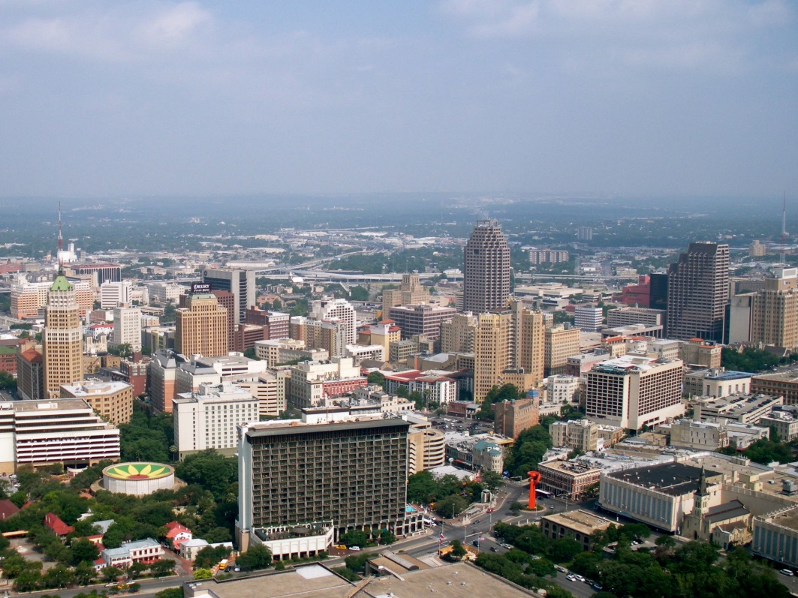
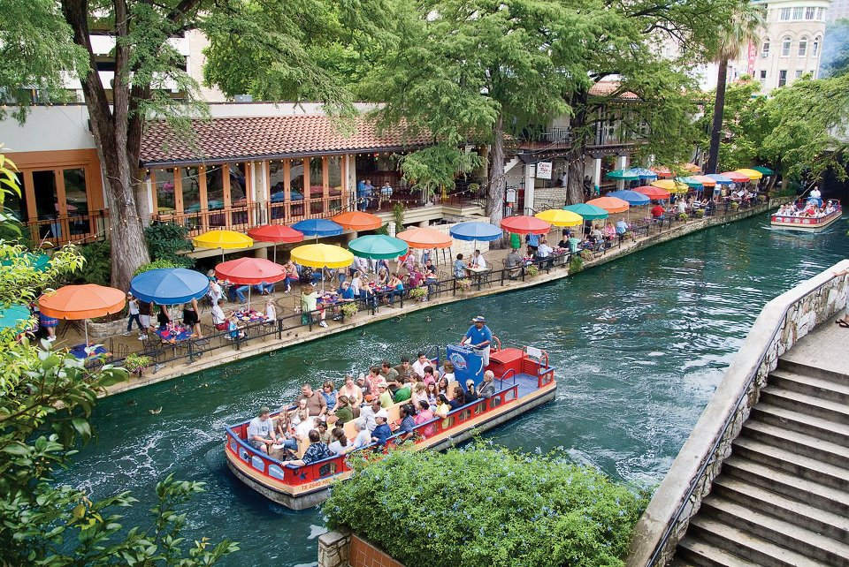
Next it was on to San Antonio, Texas, where Melanie finished her education.
http://www.americapictures.net/wp-content/uploads/2012/12/Building-Downtown-San-Antonio-Texas-United-States.jpg
You may have guessed that Melanie’s father was in the military. Military families move many times as parents are stationed in new places.
https://encrypted-tbn1.gstatic.com/images?q=tbn:ANd9GcTUnpDTuqCGRaDmk7z-Dhv13YvDCAaToP9Kpja5kYvW6wzVKk-khg

Slide 7
At Robert G. Cole High School in Texas, she was the student president of the marching band.
In college in San Antonio, Texas, Melanie played in the orchestra and earned a music degree in piano, flute, and music history.
BUT NOBODY IN COLLEGE EVER HEARD HER SING!

Slide 8
At different times in her life Melanie has been…
…a nun,
…a forklift operator for Sears,
…the head chef in an expensive Texas restaurant,
…an actor in residence at University of Texas – Austin, for Black playwright, Cheryl Hawkins,
…a teaching artist, a folk singer, and a healing singer to the very ill.

Slide 9
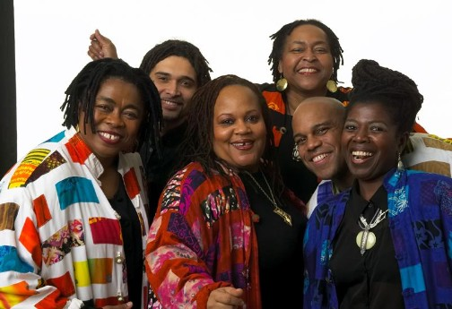
Melanie
Melanie’s whole body approach to music came from the 18 years she sang with Linda Tillery and the Cultural Heritage Choir. They specialize in and preserve African American roots music – music from the Gullah people of South Carolina and Georgia, and all kinds of old songs originally created by enslaved Africans. One of the groups founding members, Melanie, was the “sticker” – playing the pounding stick to carry a song’s rhythm. Melanie’s father’s family is from South Carolina, so her connection to the Gullah art of stick pounding runs deep.

Slide 10
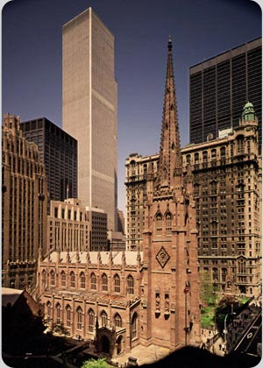
In 2011, Melanie DeMore sang in the 10th Anniversary of 9/11 Remembrance Concerts at Trinity Cathedral, New York City, in the shadow of Ground Zero.

Slide 11
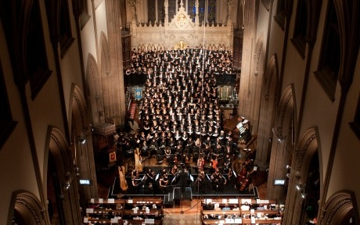
New York Times critic, James R. Oestreich, wrote:
“That night in the big concert the singer and
songwriter Melanie DeMore led the audience in
singing “Amazing Grace.” You loved the communal
spirit; you wished you could have heard more of a
solo rendition from the soulful Ms. DeMore.”

Slide 12
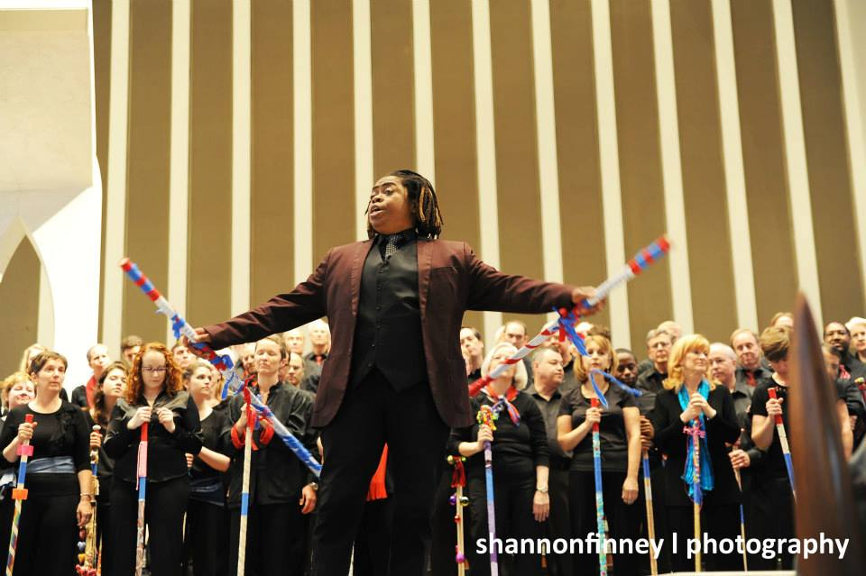
Melanie DeMore believes that when you sing, you know it deep inside, and you do it from the inside out. She works endlessly to help singers bring forth the music they have deep inside.

